Slide 1
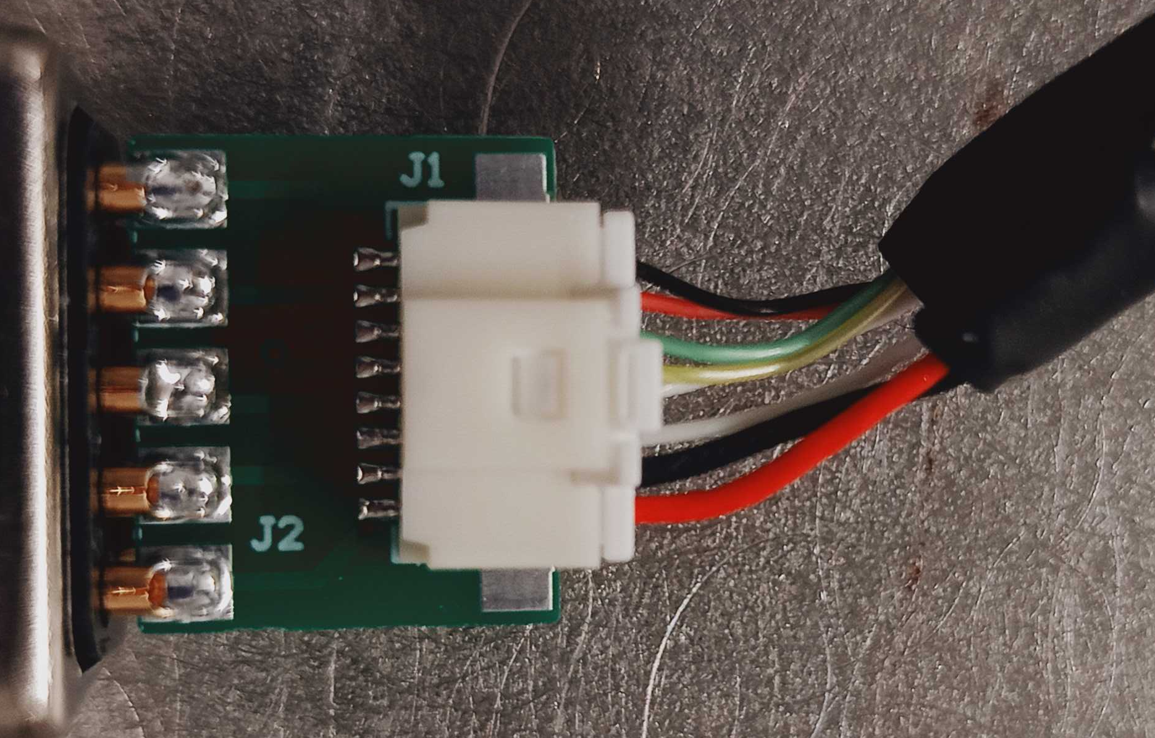
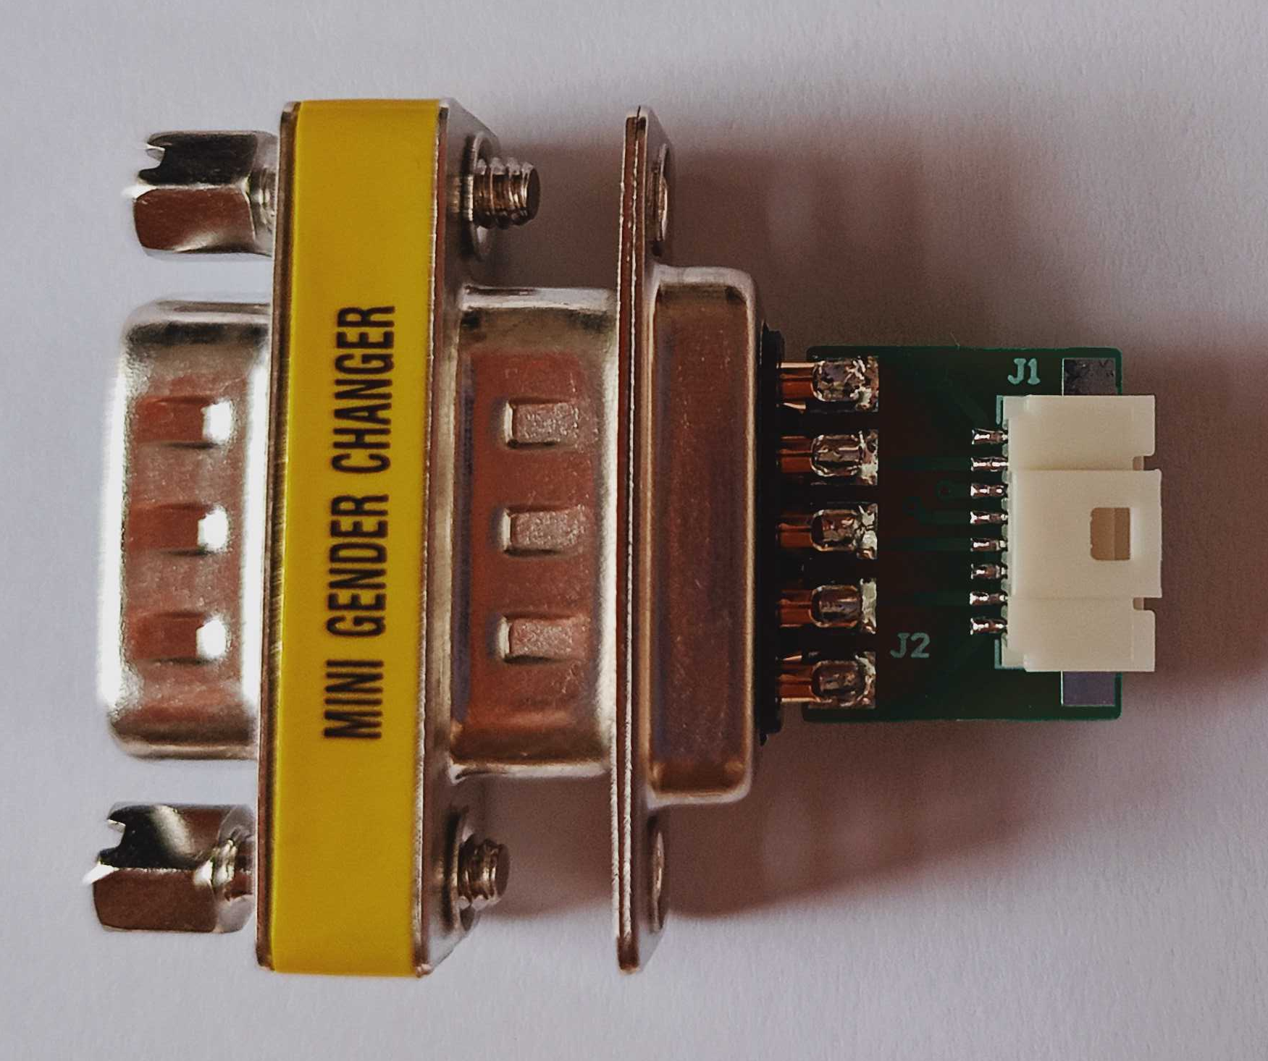
CONFOCAL CAVITY
PIEZOS CONNECTION SCHEME
AIR
VACUUM
These wires are mirrored with respect to the Trieste’s scheme
DB9 Female – Edge mount
!! The pin order is reversed here *
DB9 Female Solder + Shell
J3
J2
RED (28)
BLACK (28)
Red (32)
Black (32)
Yellow (32)
Green (32)
J1
PIEZO+
PIEZO-
SHIELD
5V
GND
X
X
ENCA+
ENCB+
1
2
3
4
5
6
7
8
9
1
2
3
4
5
6
7
8
9
PIEZO+
PIEZO-
SHIELD
5V
GND
X
X
ENCA+
ENCB+
Black (32)
Red (32)
Green (32)
Yellow (32)
BLACK (28)
RED (28)
GND
5V
ENCB+
ENCA+
SHIELD
SHIELD
PIEZO-
PIEZO+
1
2
3
4
5
6
7
8
DB15 Male
CONTROLLER
1st cable
1st cable
PIEZO
2nd cable
2nd cable
WIRE COLOURS:
1st CABLE (AWG 28)
RED: PIEZO+
BLACK: PIEZO-
2nd CABLE (AWG32)
Yellow: ENCA+
Green: ENCB+
Red: +5V
Black: GND
DB9 m-m feedthrough
* Not here
here the connection is 1 to 1

Slide 2
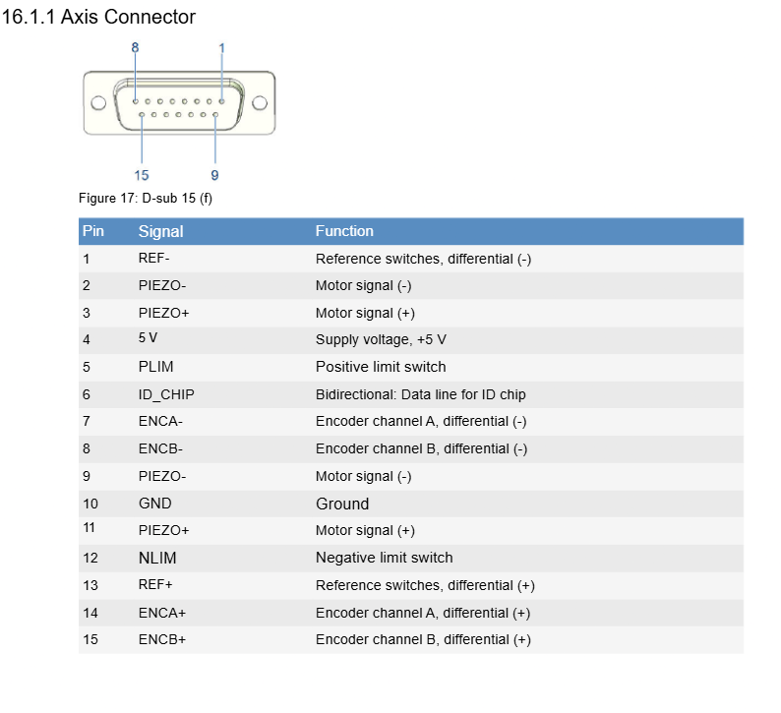
E-873 pin assignment
https://www.manualslib.com/manual/3729620/Pi-E-873-1at.html?page=212#manual

